Slide 1
Simulation
examples

Slide 2
Example B Flight (without atmosphere)
Deterministic Model

Slide 3
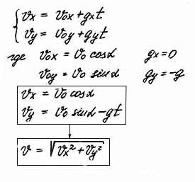
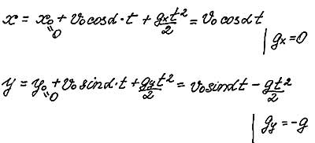
Example B Business model

Slide 4
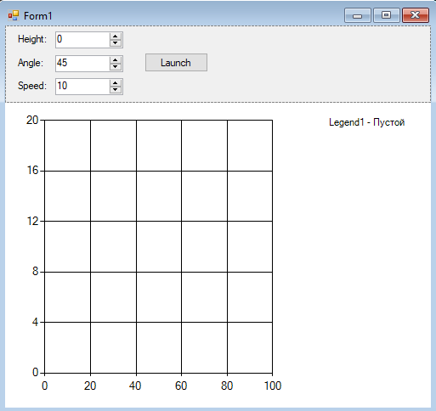
Example B Main window
Series.ChartType=Lines
ChartAreas.Axes.X and Y -> Minimum and Maximum
Chart control

Slide 5
Example B Timer + test
private void btLaunch_Click(object sender, EventArgs e)
{
timer1.Start();
}
int i = 0;
private void timer1_Tick(object sender, EventArgs e)
{
chart1.Series[0].Points.AddXY(i, Math.Sqrt(i));
i++;
}

Slide 6
Example B Formulas
decimal t, x0, y0, v0, cosa, sina;
private void btLaunch_Click(object sender, EventArgs e)
{
if (!timer1.Enabled)
{
chart1.Series[0].Points.Clear();
t = 0;
x0 = 0;
y0 = inputHeight.Value;
v0 = inputSpeed.Value;
double a = (double)inputAngle.Value * Math.PI / 180;
cosa = (decimal)Math.Cos(a);
sina = (decimal)Math.Sin(a);
chart1.Series[0].Points.AddXY(x0, y0);
timer1.Start();
}
}
const decimal g = 9.81M;

Slide 7
Example B Timer
const decimal dt = 0.1M;
private void timer1_Tick(object sender, EventArgs e)
{
t += dt;
decimal x = x0 + v0 * cosa * t;
decimal y = y0 + v0 * sina * t - g * t * t / 2;
chart1.Series[0].Points.AddXY(x, y);
if (y <= 0) timer1.Stop();
}

Slide 8
Laboratory #2
Assignments:
Add time indicator
Add pause control
More precise scaling (maximum and minimum values on axes)

